Slide 1



APEX INSTITUTE OF TECHNOLOGY
DEPARTMENT OF COMPUTER SCIENCE & ENGINEERING
Database Management System (22CSH-243)
Faculty: Ms. Shaveta Jain (13464)
Lecture – 2.1
Informal Database Design Guidelines
DISCOVER . LEARN . EMPOWER

Slide 2
DBMS: Course Objectives
COURSE OBJECTIVES
The Course aims to:
Understand database system concepts and design databases for different applications and to acquire the knowledge on DBMS and RDBMS.
Implement and understand different types of DDL, DML and DCL statements.
Understand transaction concepts related to databases and recovery/backup techniques required for the proper storage of data.

Slide 3
COURSE OUTCOMES
On completion of this course, the students shall be able to:-
CO1 | Understand the database concept, system architecture and role of database administrator
CO2 | Design database for an organization using relational model
CO3 | Apply relational algebra and relational calculus to query the database of organization
CO4 | Implement the package, procedures and triggers
CO5 | Understand the concept of transaction processing and concurrency control

Slide 4
Unit-II Syllabus
Unit-2 | FUNCTIONAL DEPENDENCIES AND NORMALIZATION
Functional dependencies and Normalization: | Functional dependencies, Decomposition, Full Functional Dependency (FFD), Transitive Dependency (TD), Join Dependency (JD), Multi-valued Dependency (MVD), Normal Forms (1NF, 2NF, 3NF, BCNF), De-normalization.
Database Security: | Introduction, Threats, Counter Measures.
Control Structures: | Introduction to conditional control, Iterative control and sequential control statements, Cursors, Views.

Slide 5
Lecture Outline
Informal Design Guidelines for Relational Databases
Semantics of the Relation Attributes
Redundant Information in Tuples and Update Anomalies
Null Values in Tuples
Spurious Tuples
Chapter 10-<number>

Slide 6
Informal Design Guidelines for Relational Databases
What is relational database design?
The grouping of attributes to form "good" relation schemas
Two levels of relation schemas
  The logical "user view" level
  The storage "base relation" level
Design is concerned mainly with base relations
What are the criteria for "good" base relations?
Chapter 10-<number>

Slide 7
Informal Design Guidelines for Relational Databases (2)
We first discuss informal guidelines for good relational design
Then we discuss formal concepts of functional dependencies and normal forms
- 1NF (First Normal Form)
- 2NF (Second Normal Form)
- 3NF (Third Normal Form)
- BCNF (Boyce-Codd Normal Form)
Chapter 10-<number>

Slide 8
Semantics of the Relation Attributes
GUIDELINE 1: Informally, each tuple in a relation should represent one entity or relationship instance. (Applies to individual relations and their attributes).
Attributes of different entities (EMPLOYEEs, DEPARTMENTs, PROJECTs) should not be mixed in the same relation
Only foreign keys should be used to refer to other entities
Entity and relationship attributes should be kept apart as much as possible.
Bottom Line: Design a schema that can be explained easily relation by relation. The semantics of attributes should be easy to interpret.
Chapter 10-<number>

Slide 9
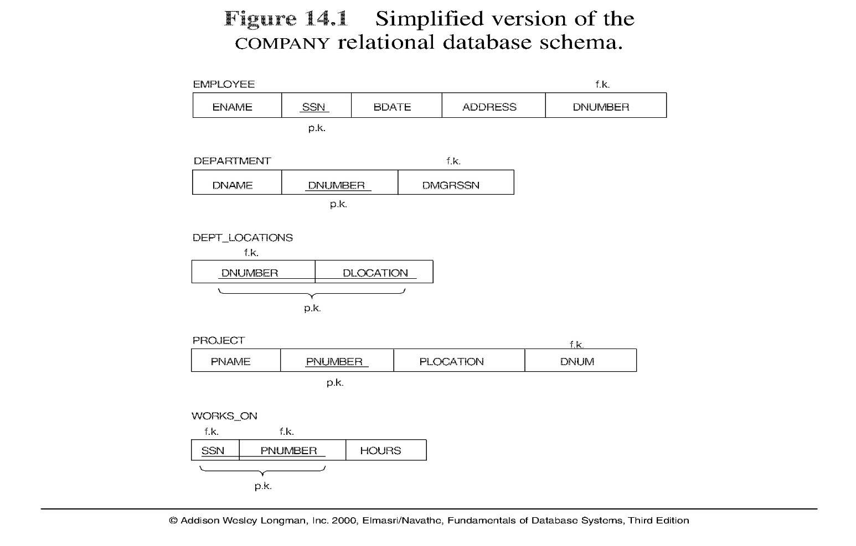
Figure: A simplified COMPANY relational database schema
Note: The above figure is now called Figure 10.1 in Edition 4
Chapter 10-<number>

Slide 10
Redundant Information in Tuples and Update Anomalies
Mixing attributes of multiple entities may cause problems
Information is stored redundantly wasting storage
Problems with update anomalies
  Insertion anomalies
  Deletion anomalies
  Modification anomalies
Chapter 10-<number>

Slide 11
EXAMPLE OF AN UPDATE ANOMALY
Consider the relation:
EMP_PROJ ( Emp#, Proj#, Ename, Pname, No_hours)
Update Anomaly: Changing the name of project number P1 from “Billing” to “Customer-Accounting” may cause this update to be made for all 100 employees working on project P1.
Chapter 10-<number>

Slide 12
EXAMPLE OF AN UPDATE ANOMALY (2)
Insert Anomaly: Cannot insert a project unless an employee is assigned to .
Inversely - Cannot insert an employee unless an he/she is assigned to a project.
Delete Anomaly: When a project is deleted, it will result in deleting all the employees who work on that project. Alternately, if an employee is the sole employee on a project, deleting that employee would result in deleting the corresponding project.
Chapter 10-<number>

Slide 13
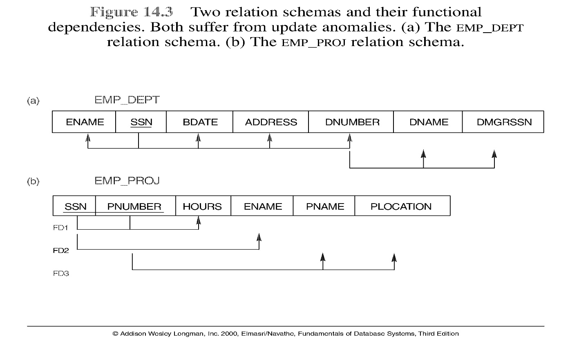
Figure: Two relation schemas suffering from update anomalies
Note: The above figure is now called Figure 10.3 in Edition 4
Chapter 10-<number>

Slide 14
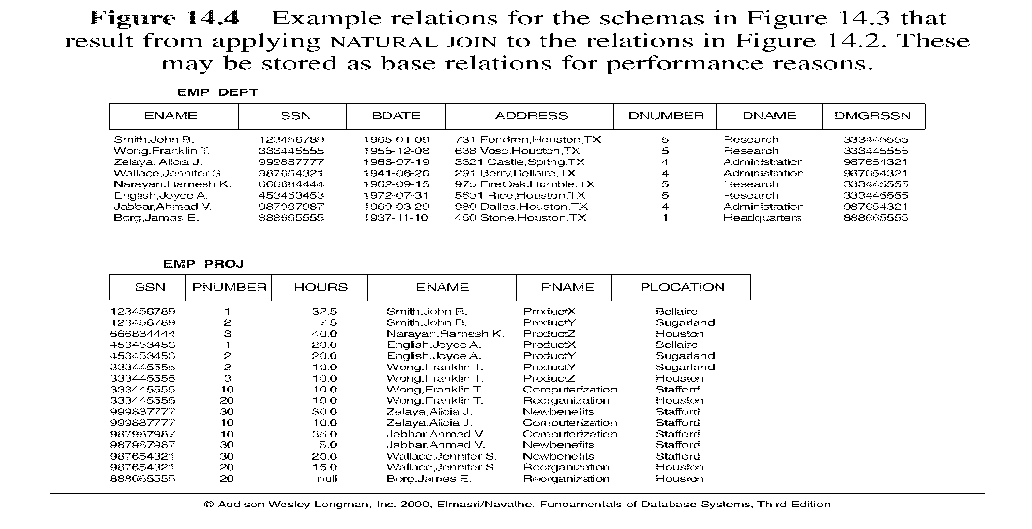
Figure: Example States for EMP_DEPT and EMP_PROJ
Note: The above figure is now called Figure 10.4 in Edition 4
Chapter 10-<number>

Slide 15
Guideline to Redundant Information in Tuples and Update Anomalies
GUIDELINE 2:
Design a schema that does not suffer from the insertion, deletion and update anomalies. If there are any present, then note them so that applications can be made to take them into account
Chapter 10-<number>

Slide 16
Null Values in Tuples
GUIDELINE 3: Relations should be designed such that their tuples will have as few NULL values as possible
Attributes that are NULL frequently could be placed in separate relations (with the primary key)
Reasons for nulls:
  attribute not applicable or invalid
  attribute value unknown (may exist)
  value known to exist, but unavailable
Chapter 10-<number>

Slide 17
Spurious Tuples
Bad designs for a relational database may result in erroneous results for certain JOIN operations
The "lossless join" property is used to guarantee meaningful results for join operations
GUIDELINE 4: The relations should be designed to satisfy the lossless join condition. No spurious tuples should be generated by doing a natural-join of any relations.
Chapter 10-<number>

Slide 18
Spurious Tuples
There are two important properties of decompositions:
non-additive or losslessness of the corresponding join
preservation of the functional dependencies.
Note that property (a) is extremely important and cannot be sacrificed.
Property (b) is less stringent and may be sacrificed.
Chapter 10-<number>

Slide 19
References
RamezElmasri and Shamkant B. Navathe, “Fundamentals of Database System”, The Benjamin / Cummings Publishing Co.
Korth and Silberschatz Abraham, “Database System Concepts”, McGraw Hall.
C.J.Date, “An Introduction to Database Systems”, Addison Wesley.
Thomas M. Connolly, Carolyn & E. Begg, “Database Systems: A Practical Approach to Design, Implementation and Management”, 5/E, University of Paisley, Addison-Wesley.

Slide 20

THANK YOU
For queries
Email: shaveta.e13464@cumail.in

